Slide 1

Stream Control Transmission Protocol (SCTP)
Janardhan Iyengar
Protocol Engineering Lab
Computer & Information Sciences, University of Delaware

Slide 2


Where is SCTP in the stack?
application
application
Transport
UDP
TCP
SCTP
DCCP
UDP lite
UDP
TCP
SCTP
DCCP
UDP lite
IP
IP
IP
CHAOS !
IP
IP
IP
IP

Slide 3
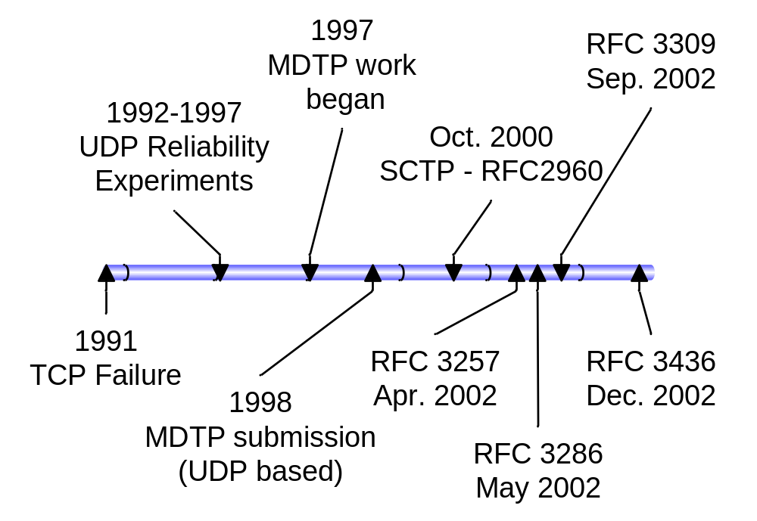
A Brief History
Primary motivation: Transportation of telephony signaling messages over IP networks
Notes:
Multi-Network Datagram Transmission Protocol
RFC 2960 – Stream Transmission Control Protocol
RFC 3257 - SCTP Applicability Statement
RFC 3286 - An introduction to SCTP
RFC 3309 – SCTP Checksum Change – from Adler-32 to CRC-32c
RFC 3436 – Transport Layer Security over SCTP
Published as RFC2960 by IETF in October 2000 as a proposed standard.
SCTP required by 3rd Generation Partnership (3GPP) – 3rd generation cellular systems
Recommended by IETF to carry AAA messages in future IP service networks (Authentication, Authorization, and Accounting)

Slide 4
RFCs
RFC 2960 – Stream Control Transmission Protocol
RFC 3257 - SCTP Applicability Statement
RFC 3286 - An introduction to SCTP
RFC 3309 – SCTP Checksum Change
RFC 3436 – Transport Layer Security over SCTP
RFC 3758 – SCTP Partial Reliability Extension
Notes:
RFC 2960 – Stream Transmission Control Protocol
RFC 3257 - SCTP Applicability Statement
RFC 3286 - An introduction to SCTP
RFC 3309 – SCTP Checksum Change – from Adler-32 to CRC-32c
RFC 3436 – Transport Layer Security over SCTP

Slide 5

SCTP – History
Origins:
Public Telephone Network Signaling
SS7 over IP (IETF Sigtran working group)
Current home: IETF TSVWG
(Transport Services Working Group)
  IETF recognizes broader scope
  Proposed Standard - RFC2960
Supported by industry:
Participation in Bakeoffs: ADAX - Cisco – HP/Compaq - Data Connection - DataKinetics - Ericsson - Hughes Software - IBM - Motorola – Netbricks - Nokia - Open SS7 - Performance Technologies - RadiSys - Siemens – Spider - Sun Microsystems - Telesoft Technologies - Toshiba - Ulticom -Wipro
Implementations: AIX, FreeBSD, Linux, QNX, Solaris, True64,
IOS (Cisco Routers), Sony PlayStation II, Mac OS, more…
Bakeoffs Date Attend
Munich | 6/00 | 12
Research Triangle Park | 10/00 | 22
Sophia Antipolis | 4/01 | 19
San Jose (Connectathon) | 2/02 | 6
U. of Essen (Germany) | 9/02 | 20
U of Delaware
6/03
11
Muenster (Germany)
7/04

Slide 6
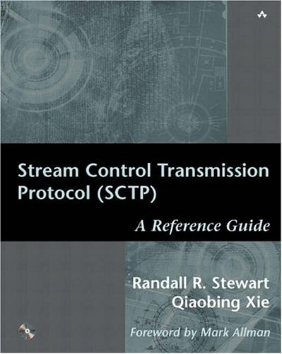

Slide 7


Slide 8
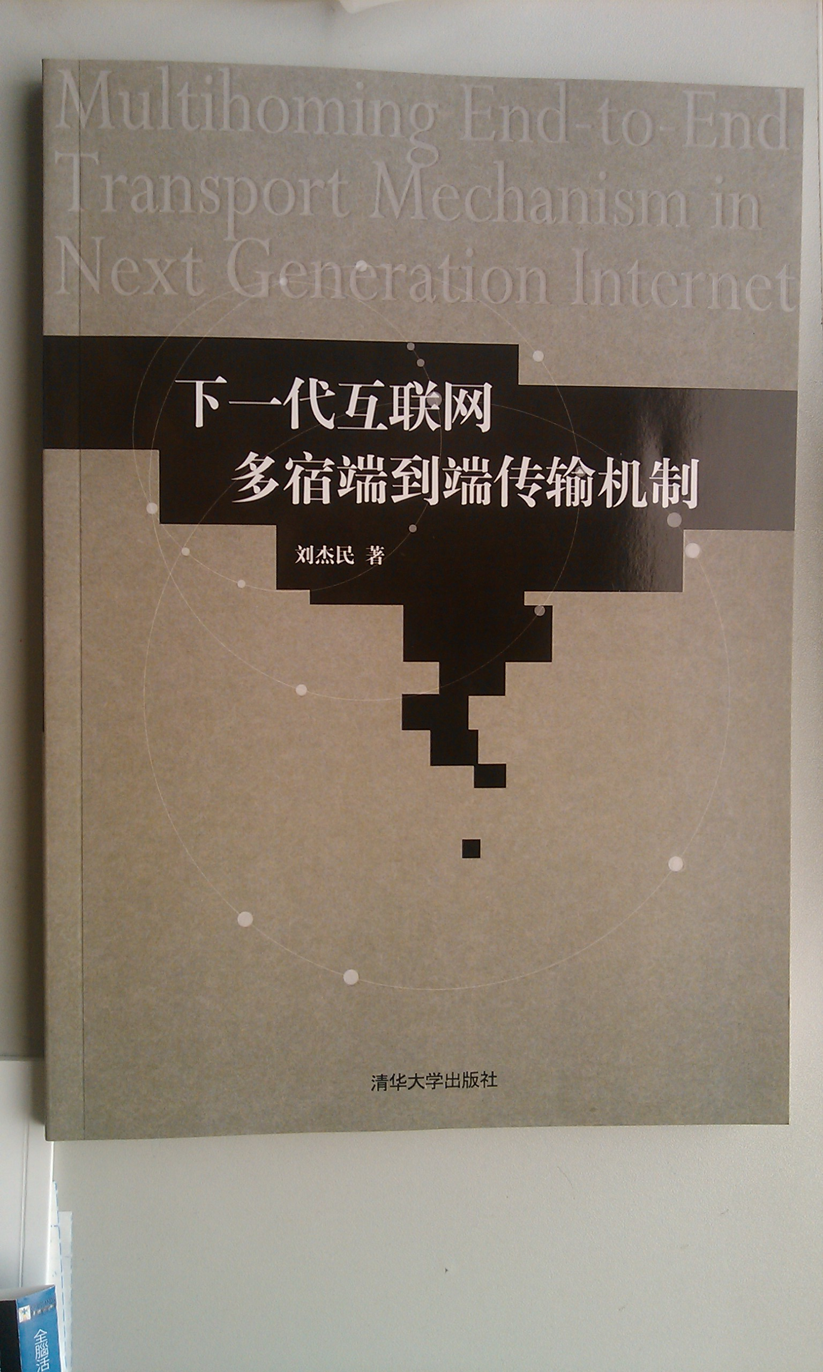

Slide 9
SCTP Feature Summary
Start with TCP:
reliable (retransmissions)
congestion controlled
connection oriented
Add:
4-way handshake
to reduce vulnerability to DOS attacks
framing
preserve message boundaries
multistreaming
instead of one ordered stream,
up to 64K independent ordered streams
multihoming
instead of one IP address per endpoint
a set of IP addresses per endpoint
Notes:
Note: will discuss

Slide 10
TCP Connection Setup
A
B
closed
t=0
SYN
listen
SYN sent
1RTT
SYN-ACK
SYN recd
(TCB created)
ACK
established
data
estab’d

Slide 11

用三次握手建立 TCP 连接
5.9.1 TCP 的连接建立
客户
服务器
A
B
主动打开
CLOSED
CLOSED
被动打开
SYN = 1, seq = x
A 的 TCP 向 B 发出连接请求报文段，其首部中的
同步位 SYN = 1，并选择序号 seq = x，表明传送
数据时的第一个数据字节的序号是 x。

Slide 12
用三次握手建立 TCP 连接
5.9.1 TCP 的连接建立
客户
服务器
A
B
主动打开
CLOSED
CLOSED
被动打开
SYN = 1, seq = x
SYN = 1, ACK = 1, seq = y, ack= x + 1
B 的 TCP 收到连接请求报文段后，如同意，则
发回确认。
B 在确认报文段中应使 SYN = 1，使 ACK = 1，
其确认号ack = x + 1，自己选择的序号 seq = y。

Slide 13
A 收到此报文段后向 B 给出确认，其 ACK = 1，
确认号 ack = y + 1。
A 的 TCP 通知上层应用进程，连接已经建立。
客户
服务器
A
B
主动打开
CLOSED
CLOSED
被动打开
SYN = 1, seq = x
SYN = 1, ACK = 1, seq = y, ack= x + 1
ACK = 1, seq = x + 1, ack = y + 1

Slide 14
B 的 TCP 收到主机 A 的确认后，也通知其上层
应用进程：TCP 连接已经建立。
客户
服务器
A
B
主动打开
CLOSED
CLOSED
被动打开
SYN = 1, seq = x
SYN = 1, ACK = 1, seq = y, ack= x + 1
ACK = 1, seq = x + 1, ack = y + 1
数据传送

Slide 15
用三次握手建立 TCP 连接的各状态
5.9.1 TCP 的连接建立
客户
服务器
A
B
主动打开
CLOSED
CLOSED
被动打开
SYN = 1, seq = x
LISTEN
SYN-
SENT
SYN = 1, ACK = 1, seq = y, ack= x + 1
SYN-
RCVD
ACK = 1, seq = x + 1, ack = y + 1
ESTAB-
LISHED
数据传送
ESTAB-
LISHED

Slide 16
SYN Flooding Attack
attackers
victim
Flooded!!
130.2.4.15
128.3.4.5
SYN
TCB
228.3.14.5
TCB
192.10.2.8
SYN
TCB
TCB
190.13.4.1
221.3.5.10
SYN
TCB
Unavailable, reserved resources
There is no ACK in response to the SYN-ACK, hence onnection remains half-open
Other genuine clients cannot open connections to the victim
The victim is unable to provide service

Slide 17
SCTP Association Setup
closed
V: Verification tag
I: Initiate tag
A
B
t=0
INIT (V=0) (I=TagA)
cookie
wait
INIT–ACK (V=TagA) (I=TagB) (StateCookie)
closed
1RTT
COOKIE–ECHO (V=TagB) (StateCookie)
cookie
echoed
COOKIE–ACK (V=TagA)
2RTT
estab’d
data (V=TagB)
established

Slide 18
What’s in a cookie?
Information from original INIT
Information from current INIT-ACK
Timestamp
Life span of cookie (Time to live)
Signature for authentication (SHA-1, MD5, etc.)

Slide 19
Graceful Shutdown
A
B
App signals shutdown
Shutdown pending
(pending data……)
SHUTDOWN
(pending data……)
Shutdown received
Shutdown sent
SHUTDOWN-ACK
Shutdown-Ack sent
SHUTDOWN-OMPLETE
Closed
Closed

Slide 20
SCTP Feature Summary
Start with TCP:
reliable (retransmissions)
congestion controlled
connection oriented
Add:
4-way handshake
to reduce vulnerability to DOS attacks
framing
preserve message boundaries
multistreaming
instead of one ordered stream,
up to 64K independent ordered streams
multihoming
instead of one IP address per endpoint
a set of IP addresses per endpoint
Notes:
Note: will discuss

Slide 21
Message Boundaries
UDP honors message boundaries
  Each app message becomes a datagram
TCP does not honor message boundaries
  App messages become part of a byte stream
SCTP maintains message boundaries
  Each app message is maintained as one or more data chunks

Slide 22
Chunks in SCTP
Source Port | Destination Port
Verification Tag
Checksum
Chunk 1
Chunk N
Common Header
SCTP
PDU
Chunks
Building blocks of an SCTP PDU
Two kinds – control chunks and data chunks
data chunks are smallest atomic data units

Slide 23
SCTP Chunk Format
Type | Flags | Length
Chunk Data
Type – e.g. Data, Init, SACK
Flags – bit meanings depend on type
Length – includes type, flags, length, and data/parameters
Notes:
General format for all chunks
Type determines what flag bits mean and whether they are used or not.
Length includes type, flags, length, and data. Minimum size is 4.
Data is optional.

Slide 24
Some Chunk Types
0x00 | DATA | User data
0x01 | INIT | ~ SYN
0x02 | INIT-ACK
0x03 | SACK | Selective ACK
0x04 | HEARTBEAT | Keep-alive message
0x05 | HEARTBEAT-ACK
0x07 | SHUTDOWN | ~FIN
0x08 | SHUTDOWN-ACK
Notes:
Chunk types may have permanent parameters specific to the chunk type. Some may also have optional parameters.

Slide 25
Example INIT Chunk
0
Permanent parameters for INIT
31
(0x30)
Chunk Type 0x01 | Flags = 0 | Length = 0x14
Initiation Tag
Receiver Window
Outbound Streams |  | Maximum Inbound Streams
Initial Transmission Sequence Number (TSN)
Parameter type 0x05 | Parameter Length = 0x0008
IPv4 Address
Parameter type 0x06 | Parameter Length = 0x0014
IPv6 Address
Some possible optional parameters for INIT.
Length of options limited only by path MTU size.
Notes:
The minimum fields for an INIT chunk include the Initiation tag, receiver window, outbound streams, max inbound streams, and TSN.
Initiation tag becomes the verification tag for the association. All future PDU’s sent by the receiver of the INIT must contain this tag. Must not be 0.
Initial TSN may be the same as the Init Tag.
Some optional fields include the initiators endpoint IP addresses. If none are specified, multihoming is not used and the IP address comes from the IP PDU. (For NAT compatibility). Chunks must start and end on 32 bit boundaries. Padding is added when necessary. Length does not include padding.

Slide 26
Data Chunk
0
31
Type = 0x00 | Flags = UBE | Length
Transmission Sequence Number (TSN)
Stream Identifier (SID) |  | Stream Seq. Num. (SSN)
User supplied Payload Protocol Identifier
User Data
Notes:
U – unordered
B – First fragment of a message
E – Last fragment of a message
TSN – Used to support fragmentation
Streams identifier – starts at 0
Stream Sequence Number - starts at 0
Payload Protocol Identifier – may be used by ULP; must be included in fragments for possible filtering

Slide 27
SACK Chunk
0
31
Type = 0x3 | Flags = 0 | Length = variable
Cumulative TSN acknowledgement
Advertised receiver window
Num. Gap ACK blocks = N |  | Num. duplicates = X
Gap ACK blk #1 start TSN offset |  | Gap ACK blk #1 end TSN offset
........
Gap ACK blk #N start TSN offset |  | Gap ACK blk #N end TSN offset
Duplicate TSN 1
……..
Duplicate TSN X
Offset is relative to cumulative TSN.
GAP ACK blocks are blocks received after cum TSN.
Notes:
GAP ACK blocks describe contiguous chunks received above cum-TSN.
SACKs are sent when there is data to send, to report any unacknowledged data that has been received.
SACKs may be delayed for a period of time (200-500 mSec) if there is no data to send
A SACK must be sent when 2 consecutive PDUs are received that contain data
When a PDU is received with duplicate data and no new data, a SACK must be sent without delay.

Slide 28
Chunk Bundling in SCTP
Source Port | Destination Port
Verification Tag
Checksum
Chunk 1
Chunk N
Common Header
SCTP
PDU
Bundling
Multiple chunks in one SCTP PDU
Control chunks bundled before data chunks
Chunk boundary cannot cross SCTP PDU boundary
Optional at sender, but receiver has to support

Slide 29
SCTP PDU
SCTP PDU
Data chunks
 |  |  |  | Message 1 |  | Message 2
Data chunk Headers
SCTP Common Header
SCTP Control Chunks
Notes:
SCTP PDU is made up of a common header and one or more chunks. (Bundling).
Bundling is optional for the sender and mandatory for the receiver.
Chunks may be for association control or for data transfer or for both. Chunks may be bundled together. If so, control chunks come first and are processed first after receipt.
Data chunks may belong to the same stream or to different streams.
Data chunks may be ordered or unordered
Chunks may not span PDU boundaries
SCTP PDU size is limited to the PMTU size – IP header size. For multi-homed hosts, smallest PMTU is used for Max PDU size.
If chunk cannot fit into a single PDU, then SCTP fragments.

Slide 30
Fragmentation/Reassembly in SCTP
Large messages are fragmented and encapsulated into several data chunks
Reassembled before delivery to receiving app
U | B | E | Description
* | 1 | 0 | (Begin) First Piece of fragmented message
* | 0 | 0 | Middle piece of fragmented message
* | 0 | 1 | (End) Last piece of fragmented message
* | 1 | 1 | Non-fragmented message
U set to 1 specifies unordered message
Note: Fragmentation req. – sequential TSN’s

Slide 31
Fragmentation Example
E.g. Message for Stream 2 from app exceeds PMTU.
Stream 2 message
 | U=0, B=1, E=0 | TSN=6 | SID=2 | SSN=1 | First data frag.
Part of Data Chunk Header
 | U=0, B=0, E=0 | TSN=7 | SID=2 | SSN=1 | Second data frag.
 | U=0, B=0, E=1 | TSN=8 | SID=2 | SSN=1 | Last data frag.
Upon completion, Stream Sequence Number increments
Notes:
Here we show the essential parts of the data chunk header for each fragment.
Note that the message itself could be ordered or unordered.
If unordered, the Stream Sequence Number is ignored.
The fragments together represent message number 1 for Stream 2. After receipt and reassembly, the Stream Sequence Number is incremented.

Slide 32
Unordered delivery
Streams by definition are ordered
Unordered data may be sent in a stream (U bit = 1)
SSN is ignored for U = 1
Unordered messages should be processed first

Slide 33
SCTP Feature Summary
Start with TCP:
reliable (retransmissions)
congestion controlled
connection oriented
Add:
4-way handshake
to reduce vulnerability to DOS attacks
framing
preserve message boundaries
multistreaming
instead of one ordered stream,
up to 64K independent ordered streams
multihoming
instead of one IP address per endpoint
a set of IP addresses per endpoint
Notes:
Note: will discuss

Slide 34
Head-of-Line Blocking in TCP
S
R
R’s App
1
2
3
ACK 2
1
4
ACK 3
2
5
ACK 3
6
ACK 3
ACK 3
PDU 3 is blocking the head of the line.

Slide 35
Head-of-line Blocking
TCP provides a single data stream
When a segment is lost, subsequent segments must wait to be processed.
Problem for some applications (telephony)
SCTP provides multiple independent streams per association

Slide 36
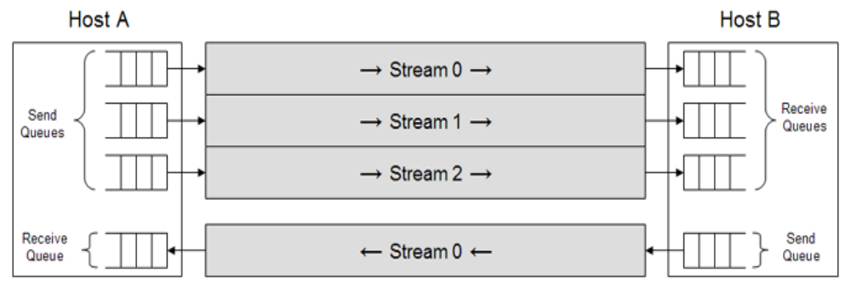
SCTP Multistreaming
Logical separation of data within an assoc
Designed to prevent head-of-line blocking
Can be used to deliver multiple objects belonging to the same assoc
  Eg: objects on a webpage, multimedia streams (audio/video/text), files in an FTP mget

Slide 37
Head-of-Line Blocking in SCTP
S
(all ordered streams)
R
App Layer
Transport Layer
App Layer
SID :SSN
TSNs
SID :SSN
1:1
3:1
1,2
1:1, 3:1
ACK 2
1:2
1:1, 3:1
3
1:2
undelivered
3:2
1:3
2:1
3:2, 1:3, 2:1
ACK 2
3:2, 2:1
4,5,6
1:4
2:2
3:3
1:4, 2:2, 3:3
7,8,9
ACK 2
2:2, 3:3
NOTE: An SCTP ACK a cum ack based onTSN.

Slide 38
Head-of-Line Blocking in SCTP
S
(stream 1 unordered)
R
App Layer
Transport Layer
App Layer
SID :SSN
TSNs
1:a
SID :SSN
3:1
1,2
3:1, 1:a
ACK 2
1:b
3:1, 1:a
3
1:b
1:c
Only blocked message
3:2
2:1
3:2, 2:1, 1:c
4,5,6
ACK 2
3:2, 2:1, 1:c
1:d
2:2
3:3
2:2, 3:4, 1:d
7,8,9
ACK 2
2:2, 3:3, 1:d
Letters show unordered chunks w/in a stream. U bit is set & SSN is ignored.

Slide 39

SCTP Multi-Homing
IP B2
IP B1
IP A1
IP B3
IP A2
IP network
Multiple src/dest ip addresses
Use of different physical paths not guaranteed
Peer reachability and path status are monitored (heartbeat)
One selectable default destination
Parameters per path (cwnd, ssthresh, RTT)

Slide 40
SCTP Feature Summary
Start with TCP:
reliable (retransmissions)
congestion controlled
connection oriented
Add:
4-way handshake
to reduce vulnerability to DOS attacks
framing
preserve message boundaries
multistreaming
instead of one ordered stream,
up to 64K independent ordered streams
multihoming
instead of one IP address per endpoint
a set of IP addresses per endpoint
Notes:
Note: will discuss

Slide 41

What is SCTP Multihoming?
A₁
ISP
Internet
ISP
B₁
A₂
ISP
ISP
B₂
HostA
HostB
Hosts pick 1 of 4 possible TCP connections:
  {(A₁, B₁), (A₁, B₂), (A₂, B₁), (A₂, B₂)}
Hosts use 1 SCTP association:
  ({A₁,A₂}, {B₁,B₂})
  Selectable “primary” dest: HostA → B₁ ; HostB → A₁
  New data sent only to primary destination
  Path status and reachability monitored (hearbeats)

Slide 42
SCTP Multihoming
Why important?
  multihoming is now happening on wide scale
  wired + wireless, multiple ISPs, etc.
Key Research Problems
  fault tolerance
  load sharing (concurrent transfer)
Notes:
concept of “primary” destination
Host A → B₁
Host B → A₁
network state (RTT, cwnd, ssthresh, …) maintained per destination

Slide 43
SCTP Research at PEL

Slide 44
(1) Concurrent Multipath Transfer (CMT)
With
current SCTP
With CMT
With TCP
Internet
Existing Paths
Path 1
ISP 1
ISP 4
ISP 2
Path 2
ISP 5
ISP 3
Path 3
ISP 6

Slide 45
CMT Protocols
CMT _{naive}
  SCTP (RFC 2960) with 1 modification
  modified SCTP to send new data to all destinations concurrently
  significant reordering observed
    Causes unnecessary fast retransmits
    Causes incorrect cwnd growth
  Where should retransmissions be sent ?
  What should sender do if paths intersect ?
CMT_{smart}
  CMT_{naive} with 3 proposed algorithms*
    split fast retransmit (“SFR-CACC”) algorithm
    cwnd update (“CUC”) algorithm
    delayed ack (“DAC”) algorithm
  Retransmissions sent to destination with largest ssthresh
  …
http://www.cis.udel.edu/~iyengar/publications/

Slide 46
(2) SCTP Retransmission Policy
Current retransmission policy
  Retransmit to an alternate destination, if exists
  Attempts to improve chances of success
  No prior research to demonstrate benefits
  this policy degrades performance in many cases
Alternate solutions
  Retransmit to same dst
  Fast retransmit to same dst, Timeouts to alternate dst
  Multiple Fast Retransmit Algorithm
  …
www.armandocaro.net/papers/

Slide 47
(3) SCTP Failover: Parameter Settings
Investigate and improve performance during failover
How do you decide when to failover to an alternate path?
  Default parameter settings (Path.Max.Retrans PMR=5) and algorithms in SCTP take too long
  when PMR=5 and minimum RTO=1s, failure detection requires at least 1+2+4+8+16+32 = 63s
  when PMR=5 and maximum RTO=60s, failure detection requires at least 6*60 = 360s
  This work investigates alternate parameter settings and algorithms
www.armandocaro.net/papers/

Slide 48
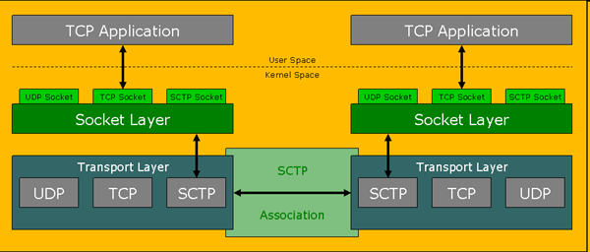
(4) Transparent SCTP Shim
Migrate existing TCP applications to SCTP transparently
Application gains: fault tolerance, SACK support
http://www.cis.udel.edu/~bickhart/research.html

Slide 49
(5) Other PEL Contribution
SCTP module for ns-2 (in Ver2.27 or greater) – most widely used network simulator in research community
  downloaded and used by several researchers
  part of coursework / course projects (UCLA, TAMU, UF, …)
SCTP module for tcpdump (in ver. 3.7 or greater)
Available at http://pel.cis.udel.edu

Slide 50
Services/Features
SCTP
TCP
UDP
Connection-oriented
yes
yes
no
Full duplex
yes
yes
yes
Reliable data transfer
yes
yes
no
Partial-reliable data transfer
proposed
no
no
Flow control
yes
yes
no
TCP-friendly congestion control
yes
yes
no
ECN capable
yes
yes
no
Ordered data delivery
yes
yes
no
Unordered data delivery
yes
no
yes
Uses selective ACKs
yes
optional
no
Path MTU discovery
yes
yes
no
Application PDU fragmentation
yes
yes
no
Application PDU bundling
yes
yes
no
Preserves application PDU boundaries
yes
no
yes
Multistreaming
yes
no
no
Multihoming
yes
no
no
Protection against SYN flooding attack
yes
no
n/a
Allows half-closed connections
no
yes
n/a
Reachability check
yes
yes
no
Pseudo-header for checksum
no (uses vtags)
yes
yes
Time wait state
for vtags
for 4-tuple
n/a

Slide 51
Resources
Randall R. Stewart, Qiaobing Xie, 2002, “Stream Control Transmission Protocol (SCTP) A Reference Guide
Stewart et. al., Stream Contol Stream Transmission Protocol RFC-2960, October 2000.
  URL: http://www.ietf.org/rfc/rfc2960.txt
Ong L. and J. Yoakum, May 2002, “An Introduction to the Stream Control Transmission Protocol (SCTP)”
  URL: http://www.ietf.org/rfc/rfc3286.txt
Caro Jr. et al, “SCTP: A Proposed Standard for Robust Internet Data Transport”, November 2003, IEEE Computer
  http://www.eecis.udel.edu/~amer/PEL/poc/index.html#pubs
Protocol Engineering Lab: http://pel.cis.udel.edu

Slide 52

Questions ?

Slide 53
Extra slides

Slide 54
Outline
those who know TCP
those who have
taken networks
those in computer science
those in the audience
SCTP research
What is SCTP ?
What is a transport protocol ?
What are the components of the Internet ?
brief personal comments

Slide 55
Research Project I:
Improving FTP Using SCTP Multistreaming

Slide 56
File Transfer Protocol
control connection
FTP
server
FTP
client
data connection
n+1 TCP connections
Notes:
out-of-band signaling
data connection is non-persistent

Slide 57
Classic FTP over TCP
Client
Server
PORT
200
NLST
SYN
Redundant round trips
SYN-ACK
ACK
150
NAME LIST
FIN
226
FIN-ACK
ACK
PORT
200
213
SIZE
RETR
SYN
ACK
SYN-ACK
150
DATA
FIN
FIN-ACK
226
ACK

Slide 58
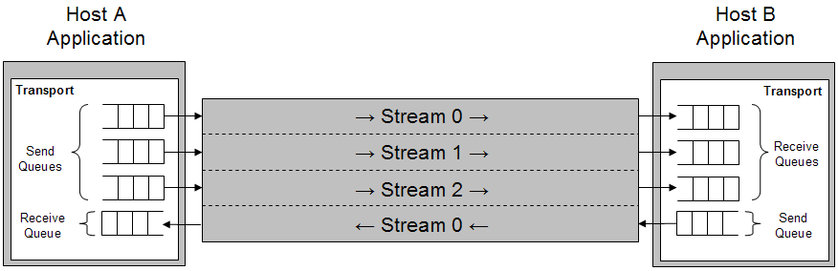
Using multistreaming in FTP
FTP
client
FTP
server
control stream
data stream
1 SCTP association
Notes:
single SCTP association for entire FTP session
two streams: one for control and one for data
Multiple streams within a single SCTP association
All streams share the same congestion control parameters
Reliability mechanism: per association
Delivery mechanism: per stream

Slide 59
FTP over TCP
FTP over multistreamed SCTP
FTP over multistreamed SCTP with command pipelining
Client
Server
Client
Server
Client
Server
PORT
200
NLST
NLST
NLST
SYN
SYN-ACK
150
150
ACK
DATA
DATA
150
226
226
DATA
SIZE
SIZE
FIN
213
SIZE
213
226
RETR
RETR
FIN-ACK
213
150
150
RETR
PORT
DATA
ACK
DATA
226
200
226
SIZE
213
RETR
SYN
SYN-ACK
ACK
150
DATA
FIN
226
Notes:
I. Separate data and control connections
Extra round trips involved in setting up a connection
Control connection always in slow start
Number of connections at the server doubles, TCB memory overheads
NAT interactions, security considerations
II. Non-persistence of the data connection
Redundant round trips for every data transfer request (command exchange and setup/teardown)
Unnecessary probing of the congestion window (cwnd) for each data connection in the event of multiple file transfers
Increasing server load. (TCP TIME_WAIT state)

Slide 60
FTP over multistreamed
SCTP
FTP over multistreamed
SCTP with command pipelining
Client
Server
Client
Server
stream 0
NLST
stream 0
NLST
stream 0
stream 0
150
stream 1
150
stream 1
Name List
Name List
stream 0
stream 0
stream 0
226
stream 0
226
SIZE
stream 0
SIZE
stream 0
stream 0
SIZE
stream 0
stream 0
213
stream 0
213
RETR
stream 0
213
RETR
stream 0
stream 0
RETR
150
stream 1
150
stream 1
DATA
DATA
stream 0
stream 0
226
226

Slide 61
Experimental Setup
bandwidth = BW delay = D
FTP
server
FTP
client
Traffic shaper
bandwidth = BW delay = D
Bandwidth-Delay Configurations:
1Mbps-35ms : US end-to-end coast
256Kbps-125ms : Satellite communication
3Mbps-1ms : UAV communication
Loss probability: {0, .01, .03, .06, .10}
Loss probability distribution: Uniform
File sizes: {10K, 50K, 200K, 500K, 1M}
Number of files transferred: {10, 100}

Slide 62
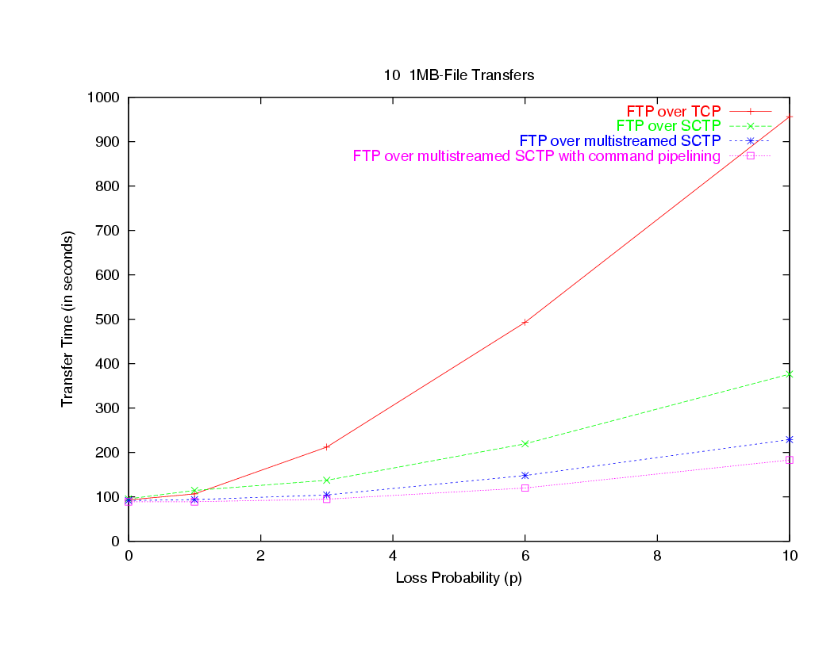
End-to-End configuration: 1Mbps - 35ms
Notes:
1st observation (surprise): FTP over SCTP did better than FTP over TCP
reason – our TCP did not have features such as limited transmit (LT), appropriate byte counting (ABC)
2nd observation: multistreaming helps, pipelining helps even more
why? fewer connection opens/closes, cwnd does not collapse to min size between files

Slide 63
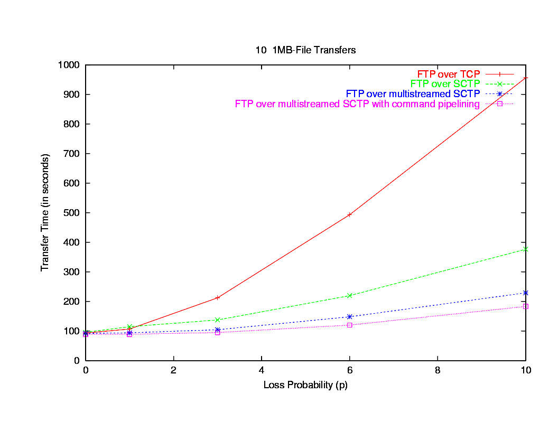
End-to-End configuration: 1Mbps-70ms

Slide 64
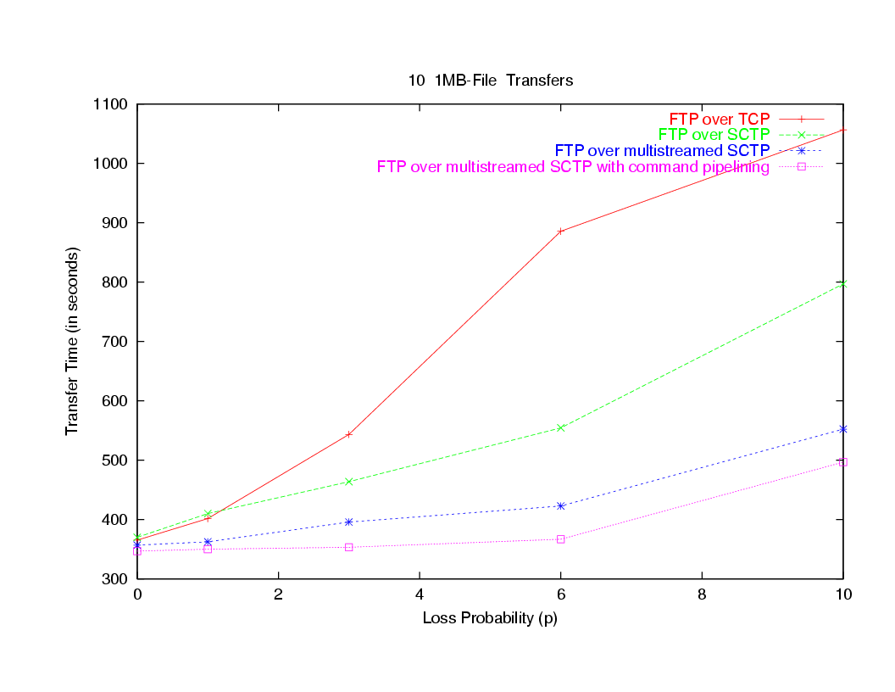
End-to-End configuration: 256Kbps - 125ms
Notes:
Observation: similar results for other configuration with same Delay * Bandwidth product
Currently testing for 100 file transfers similar to large file system backups

Slide 65
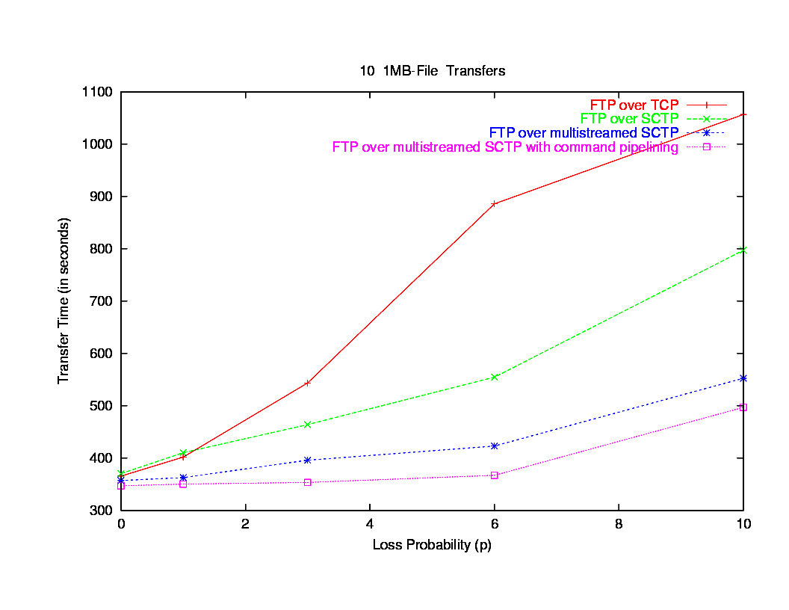
End-to-End configuration: 256Kbps- 250ms

Slide 66
Results
FTP over SCTP with multistreaming/pipelining
dramatically reduces end-to-end latency in multiple file transfers, and in a TCP-friendly manner
reduces the server load (by decreasing the number of connections)
reduces the network load
maintains simplicity at the application

